Slide 1


Maternal Mortality: How does the U.S. compare to the rest of the world?
Kimberly Gonzalez
DSC680 APPPLIED DATA SCIENCE
SPRING 2022 – BELLEVUE UNIVERSITY

Slide 2

Background
“Women in the U.S. are the most likely to die from complications related to pregnancy or childbirth.
In 2018, there were 17 maternal deaths for every 100,000 live births in the U.S. – a ratio more than double that of most other high-income countries.” (Roosa Tikkanen, 2020)
The Commonwealth Fund reports the U.S. has:
The highest Maternal Mortality rate among developed countries
Overrepresentation of OB-GYN’s in its maternity care workforce relative to midwives
And an overall shortage of maternity care providers (OB-GYN’s and Midwives) relative to birth’s
Additionally, the U.S. does not guarantee access to provider home visits or paid parental leave in the postpartum period despite studies showing that most maternal deaths take place post-birth.

Slide 3
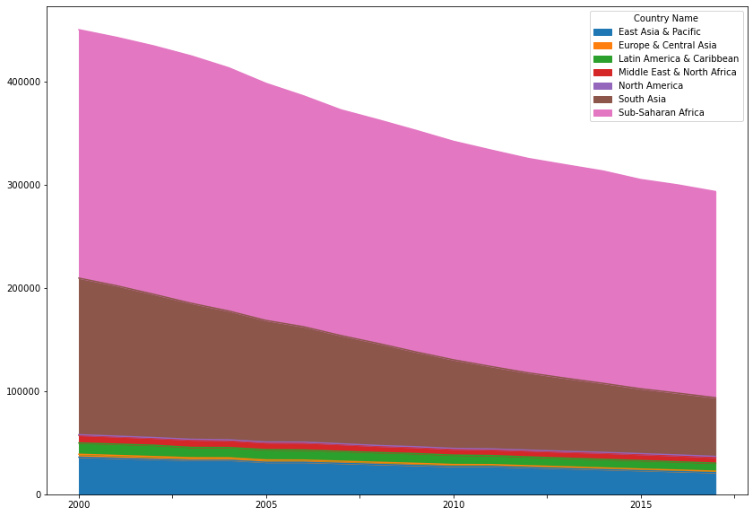
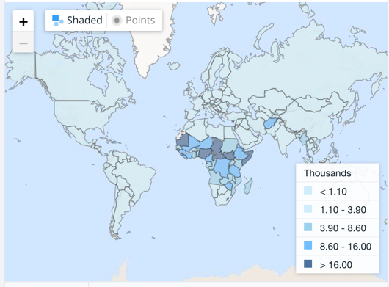
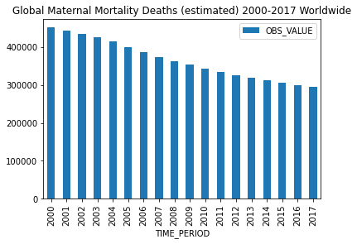
Global Maternal Mortality Rates
One study suggests Global Maternal Mortality Rates (MMR) have decreased roughly 44% since 1990.
UNICEF data for the years between 2000-2017 confirm that estimated Maternal-related deaths have seen a steady decreased since 2000 (Figure 1.)
Figure 2.
Figure 2.
Data shows that from about 2000-2018, Sub-Saharan Africa and South Asia hold the two highest rates of maternal-related deaths per 100,000 live births (MMR)(Figure 2.).
Figure 1.

Slide 4
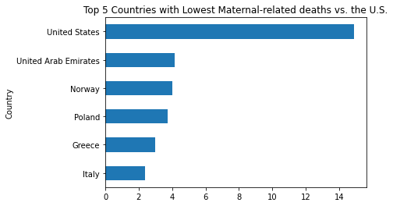
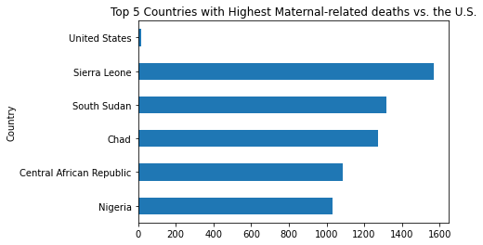
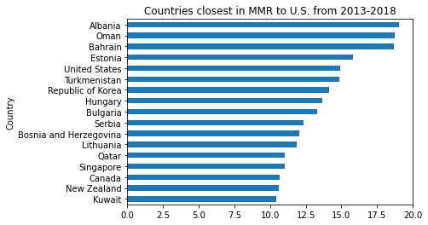
Global Maternal Mortality Rates continued…
For the years between 2013-2018, data showed that the top 5 countries with the Highest and Lowest MMR were the following:
Lowest:
Italy
Greece
Poland
Norway
United Arab Emirates
For this timeframe, the U.S. MMR was 14.8, in comparison the lowest (Italy) was 2.38, and the highest (Sierra Leone) was 1571.1.
For the same timeframe, I looked at countries closest in MMR to the U.S. to identify if those countries were generally developed countries, of which only one (Canada), is considered to be a developed country.
Highest:
Sierra Leone
South Sudan
Chad
Central African Republic
Nigeria

Slide 5
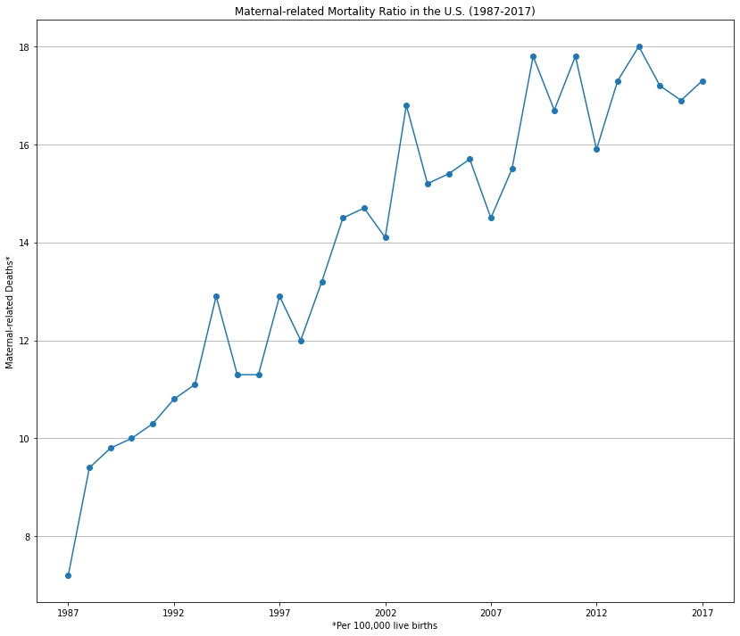
U.S. Maternal Mortality Ratio
CDC data shows that when looking at the U.S. individually, the number of reported maternal-related deaths in the U.S. has increased from 7.2 deaths per 100,000 live births since 1987 to 17.3 in 2017 (the last available year of data).

Slide 6
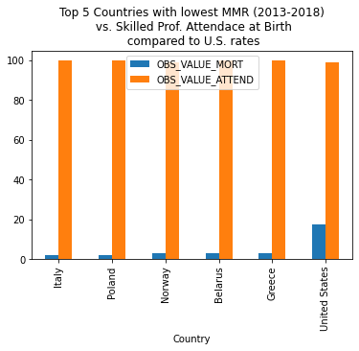
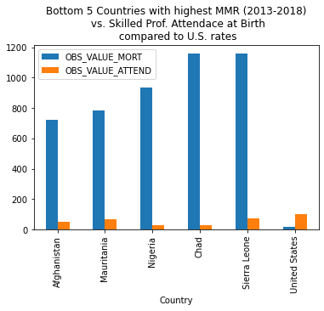
Attendance by Skilled Birth Attendant
Studies published by many organizations such as the the World Health Organization (WHO) recommend midwives as an evidence-based approach to reducing maternal mortality.
Data shows us that of the Top 5 countries with Lowest and Highest MMR Rates, there is a correlation between skilled birth attendant rates and mortality rates.
The attached charts show those 5 countries for each group as well as the U.S.’s rates for comparison.
Interestingly enough, despite the U.S. having a similar attendance rate of skilled birth professional, the mortality rates compares to the group with lowest MMR is significantly higher.

Slide 7
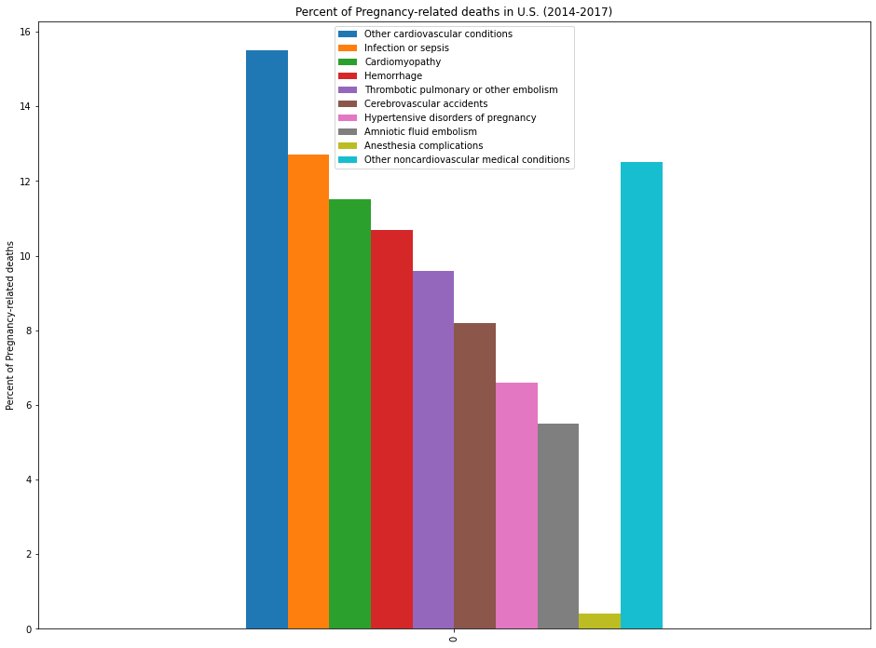
Maternal Deaths by Cause
Data obtained from the CDC shows that for pregnancy-related deaths in the U.S. from 2014-2017, the biggest contributing factor was cardiovascular conditions at 15.5%.
The CDC reports that studies show that “an increasing number of women in the U.S. have chronic health conditions such as hypertension, diabetes, and chronic heart disease. These conditions may put a woman at higher risk of complications during pregnancy or the postpartum year.”
**It should be noted the CDC is unable to account for the cause of death of 6.7% of pregnancy-related deaths during this timeframe.

Slide 8
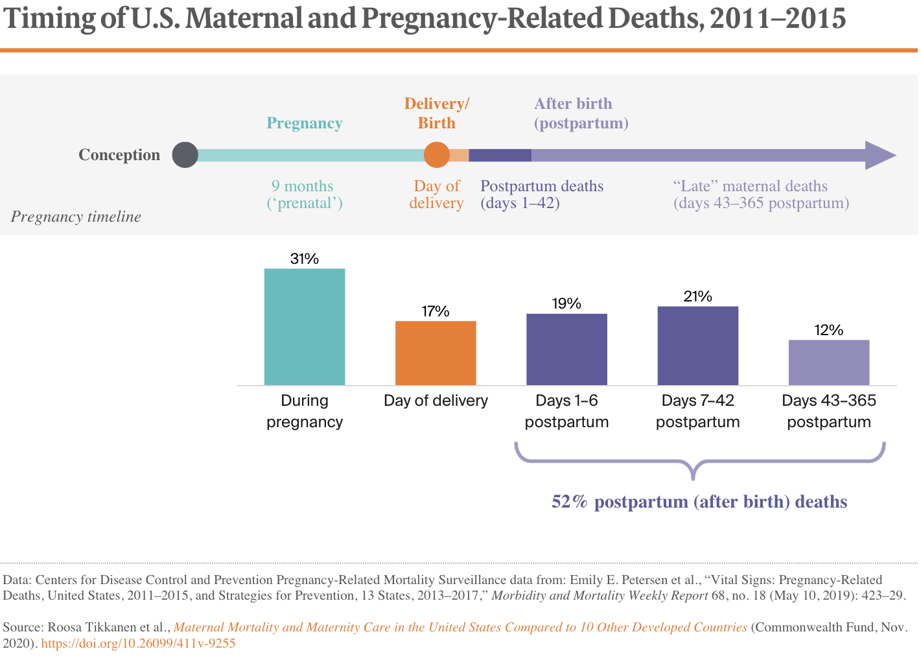
Maternal Deaths by Cause
Data provided by the Commonwealthfund.org,
reports that in the U.S. about 17% of pregnancy-related deaths occur on the day of delivery, 52% occur after delivery or postpartum.

Slide 9
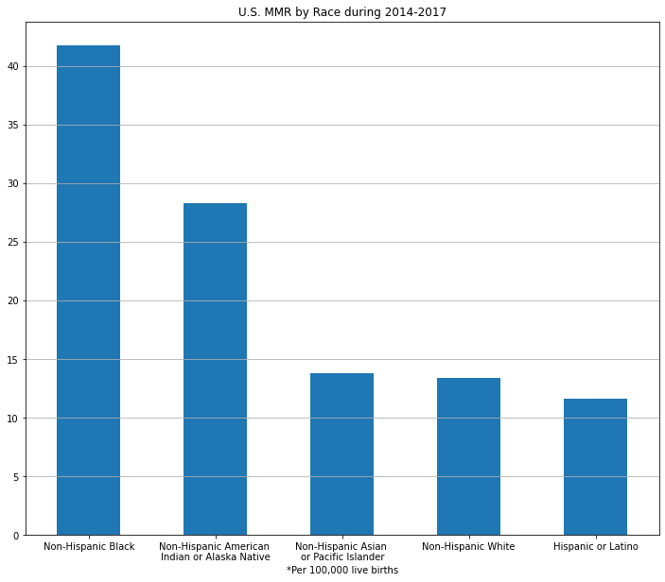
Race as a factor
CDC data shows that for years between 2014-2017 the leading group with the highest MMR was Non-Hispanic Black women with 41.7 deaths per 100,000 live births.
In contrast, the lowest group was Hispanic or Latina, with 11.6 deaths per 100,000 live births.
The CDC notes the “Variability in the risk of death by race/ethnicity may be due to several factors including access to care, quality of care, prevalence of chronic diseases, structural racism, and implicit biases”

Slide 10
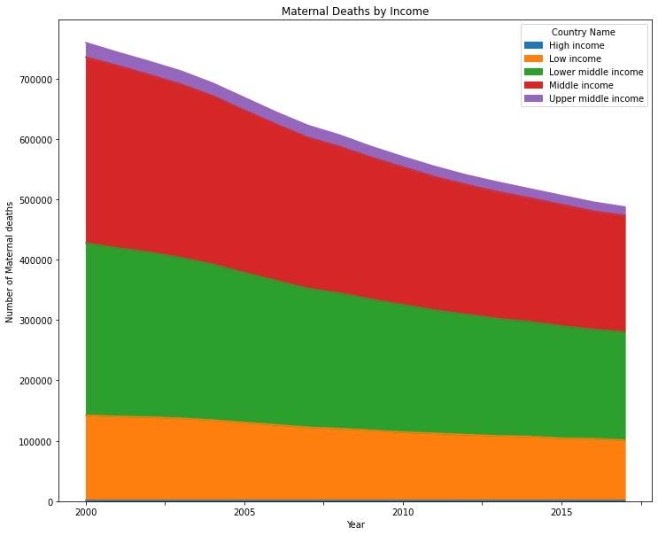
Does income play a factor?
If we evaluate MMR against income status data provided through The World Bank, the numbers of maternal deaths globally regardless of income group have all seen a decline since 2000, with the exception of the low income group (orange*) which has seen a steady rate of maternal deaths since 2000.

Slide 11
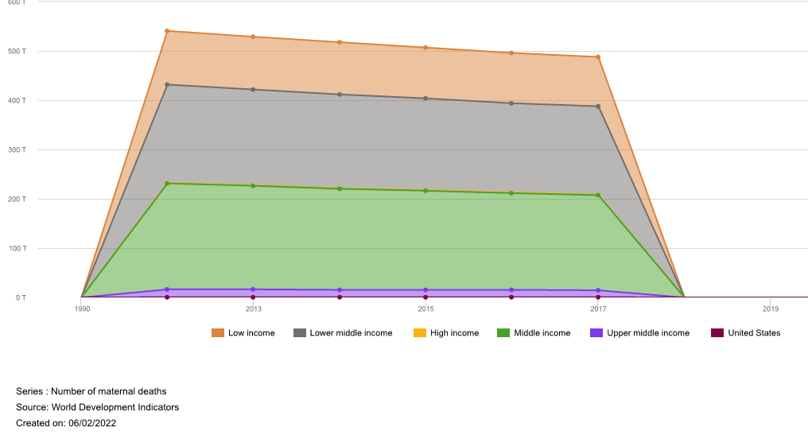
Does income play a factor, continued..
When looking at the U.S. individually, that same data shows Low Income and Lower middle income groups have seen a steady decline in number of maternal deaths whereas Middle income and Upper middle income have remained fairly consistent.

Slide 12
Final Thoughts
The U.S. does in fact have poor maternal mortality rates when compared globally, particularly with other developed countries.
A combination of contributing factors may be the cause, such as:
Disparities among racial and economic groups
Poor healthcare resources and access
Different approach to standard pre and post natal care in the U.S., in comparison to other developed countries with low MMR

Slide 13
Q&A
What do you believe to be the biggest contributing factor to the U.S. MMR?
What can the U.S. do to improve its MMR?
Do you have any personal experiences that align with this research?
Do believe there to be a racial disparity in access to maternal healthcare & resources?
What was the most difficult part of conducting this analysis?
Are there other areas/factors you would like to consider in future research?
Are there other factors that should be considered in determining future MMR?
Why do you believe the U.S. has such low antenatal care rates?
Do you think the MMR in the U.S. is divided by race?
If so, what do you believe to be the reason?
Is there anything you would have done differently for this research?

Slide 14
Key Terms
Term | Definition
Maternal Mortality | It should be noted that during this analysis various terms were identified as being used in the U.S. to measure maternal deaths, which vary slightly in definition (Roosa Tikkanen, 2020): Maternal Mortality or a Maternal Death refers to the death of a woman while pregnant or within 42 days of termination of pregnancy, irrespective of the duration and site of the pregnancy, from any cause related to or aggravated by the pregnancy or its management but not from accidental or incidental causes. This is the term is used by the WHO in international comparisons, this measure is reported as a ratio per 100,000 births. Pregnancy-associated death refers to death while pregnant or within one year of the end of the pregnancy, irrespective of cause. Pregnancy-related death refers to death during pregnancy or within one year of the end of pregnancy from a pregnancy complication, a chain of events initiated by pregnancy or the aggravation of an unrelated condition by the physiologic effects of pregnancy. Used in the U.S. only, this CDC measure is typically reported as a ratio per 100,000 births.
THE MATERNAL MORTALITY RATIO (MMR), EXPLAINED | The numbers can get a bit confusing here, so a quick explanation on the WHO’s Maternal Mortality Ratio may be useful. The WHO calculates maternal mortality risk for a country relative to the number of live births it experiences. Since those numbers are different for most countries, an accurate way of comparing maternal mortality rates around the world is to look at the number of maternal deaths per every 100,000 live births. By honing in on “live births,” the WHO also rules out stillbirths for a greater sense of accuracy. (Trayler-Smith, 2022)
Skilled Birth Attendant/Professional | Skilled health personnel (generally doctors, nurses or midwives). According to the revised definition these are competent maternal and newborn health (MNH) professionals educated, trained and regulated to national and international standards. They are competent to: 1. Provide and promote evidence-based, human-rights based, quality, socio-culturally sensitive and dignified care to women and newborns; 2. Facilitate physiological processes during labour and delivery to ensure a clean and positive childbirth experience; and 3. Identify and manage or refer women and/or newborns with complications. Traditional birth attendants, even if they receive a short training course, are not included.
Developed Country | Countries may be classified as either developed or developing based on the gross domestic product (GDP) or gross national income (GNI) per capita, the level of industrialization, the general standard of living, and the amount of technological infrastructure, among several other potential factors. According to the United Nations (UN), a nation's development status is a reflection of its "basic economic country conditions." The human development index (HDI) is a metric developed by the United Nations that's used to assess the social and economic development levels of countries based on life expectancy, educational attainment, and income, which serves as an alternate means of assessing a nation's development status. The United States was the richest developed country on Earth in 2020, with a total GDP of $20.95 trillion. China was the richest developing country on Earth in 2020, with a total GDP of $14.72 trillion.

Slide 15
Data Dictionary
Section | Data Sources
Background | The data used for this section was obtained by The Commonwealth Fund – a private foundation established in 1918 whose mission is to promote a high-performing health care system that achieves better access, improved quality, among other things, for society’s most vulnerable, including low-income people, the uninsured, and people of color. https://www.commonwealthfund.org/publications/issue-briefs/2020/nov/maternal-mortality-maternity-care-us-compared-10-countries#1
Global Maternal Mortality Rates | The data used for this section was obtained from the UNICEF Data Warehouse: https://data.unicef.org/resources/data_explorer/unicef_f/?ag=UNICEF&df=GLOBAL_DATAFLOW&ver=1.0&dq=.MNCH_MATERNAL_DEATHS+MNCH_LTR_MATERNAL_DEATH+MNCH_MMR+COD_MATERNAL_CONDITIONS+MNCH_ANC1+MNCH_ANC4+MNCH_SAB.F.&startPeriod=1970&endPeriod=2022 GLOBAL_DATAFLOW_1970-2022.xlsx Additional data sources were obtained from The World Bank Data: https://data.worldbank.org/indicator/SH.MMR.DTHS API_SH.MMR.DTHS_DS2_en_excel_v2_4024797.xls
U.S. Maternal Mortality Ratio | The data used for this section was obtained from the CDC Pregnancy Mortality Surveillance System https://www.cdc.gov/reproductivehealth/maternal-mortality/pregnancy-mortality-surveillance-system.htm trends_in_pregnancy_related_mortality_in_the_united_states__1987_2017.csv
Attendance by Skilled Birth Attendant | The data used for this section was obtained from the UNICEF Data Warehouse: https://data.unicef.org/resources/data_explorer/unicef_f/?ag=UNICEF&df=GLOBAL_DATAFLOW&ver=1.0&dq=.MNCH_MATERNAL_DEATHS+MNCH_LTR_MATERNAL_DEATH+MNCH_MMR+COD_MATERNAL_CONDITIONS+MNCH_ANC1+MNCH_ANC4+MNCH_SAB.F.&startPeriod=1970&endPeriod=2022 GLOBAL_DATAFLOW_1970-2022.xlsx
Maternal Deaths by Cause | The data used for this section was obtained from the CDC Pregnancy Mortality Surveillance System https://www.cdc.gov/reproductivehealth/maternal-mortality/pregnancy-mortality-surveillance-system.htm causes_of_pregnancy_related_death_in_the_united_states__2014_2017.csv
Race as a factor | The data used for this section was obtained from the CDC Pregnancy Mortality Surveillance System https://www.cdc.gov/reproductivehealth/maternal-mortality/pregnancy-mortality-surveillance-system.htm pregnancy_related_mortality_ratio_by_race_ethnicity__2014_2017.csv
Does income play a factor? | The data used for this section was obtained from The World Bank Data: https://data.worldbank.org/indicator/SH.MMR.DTHS API_SH.MMR.DTHS_DS2_en_excel_v2_4024797.xls

Slide 16
Sources

